Slide 1

Who is MyFORESTS.ch?
An independent Swiss think tank driving ecological and social transformation.
Where technology, science and local wisdom grow sustainable solutions for generations.

Slide 2

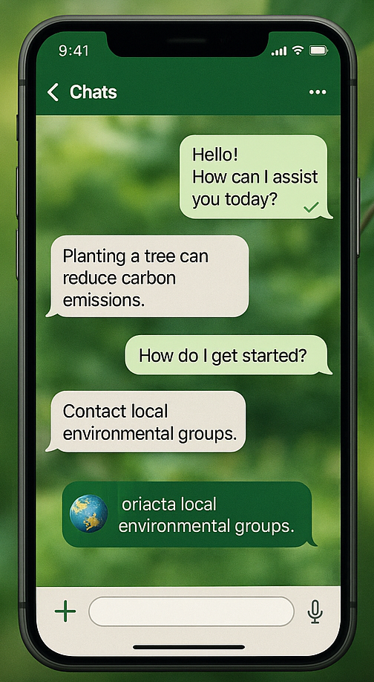

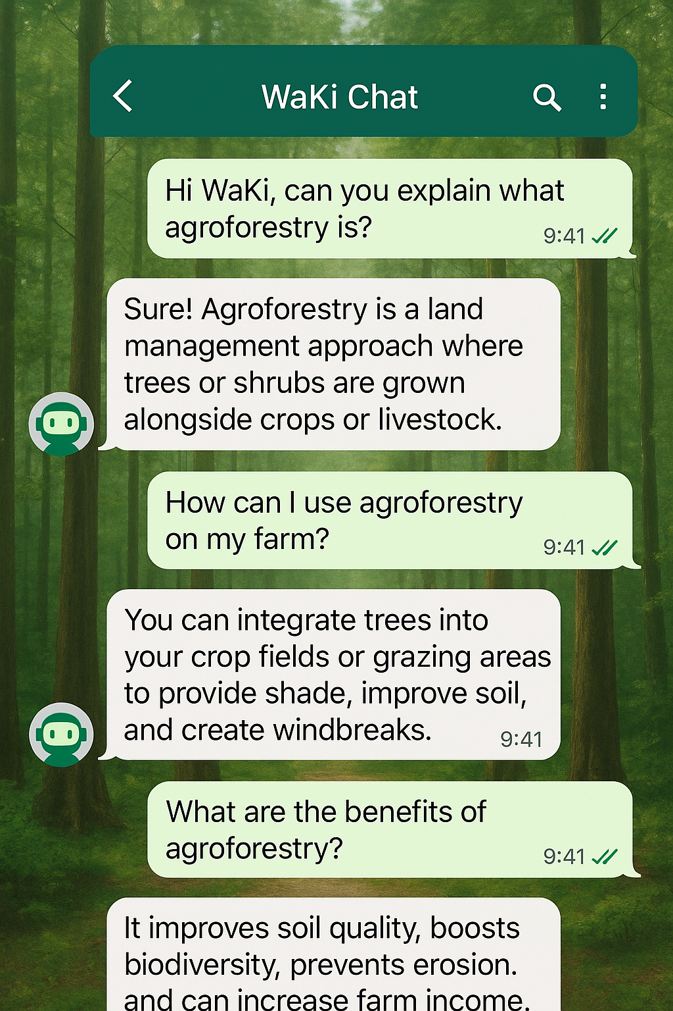
INTRODUCING
WaKI - AI-powered Q&A on WhatsApp
Focused on Environment, Education, Hygiene & Water-Life
Wa
KI
Dialogue
Language
Reliability
Developed in 2025 by the Think Tank MyFORESTS.ch

Slide 3

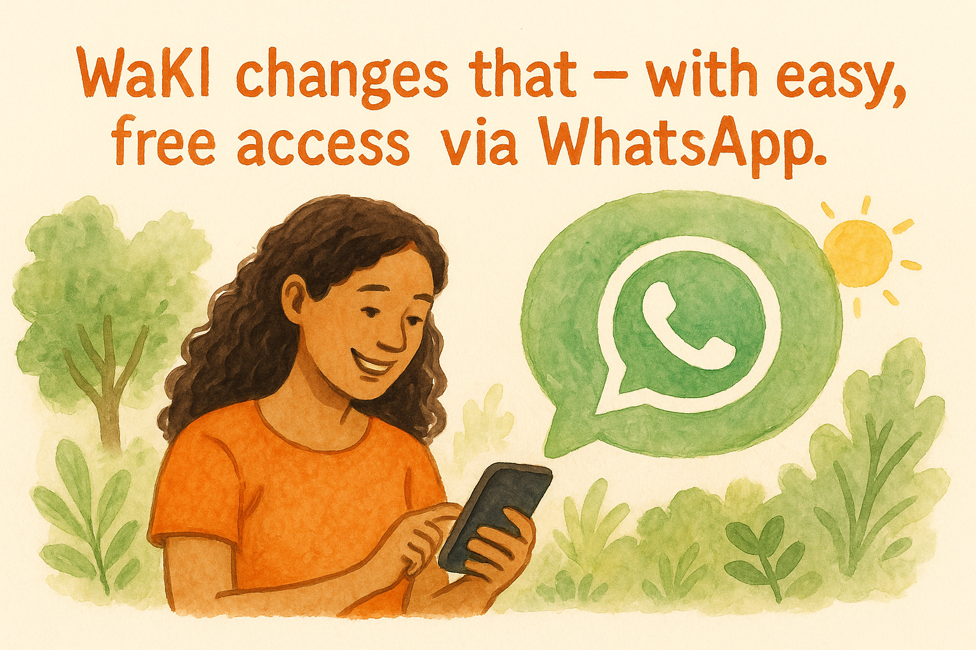
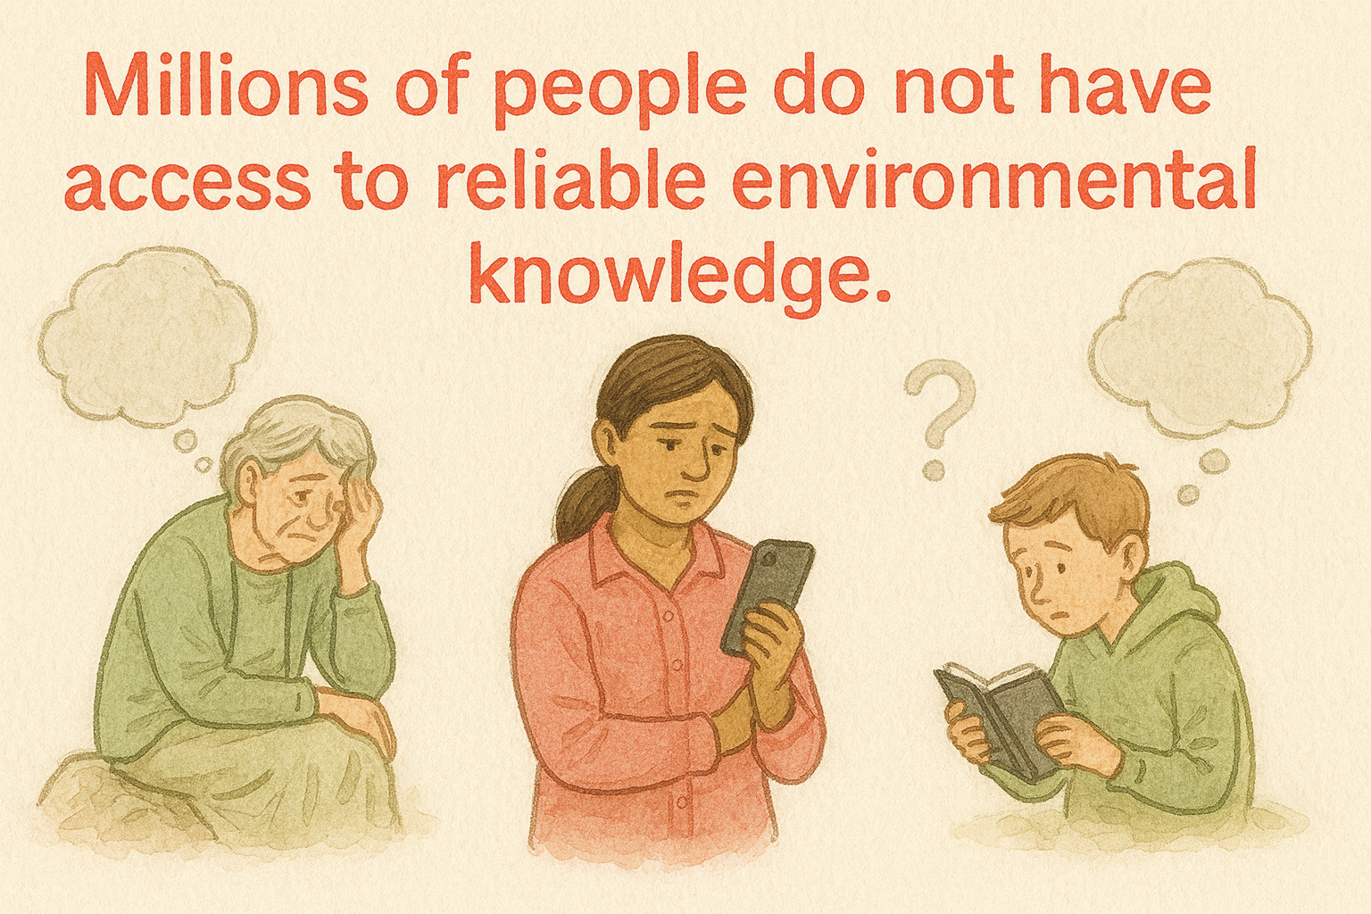
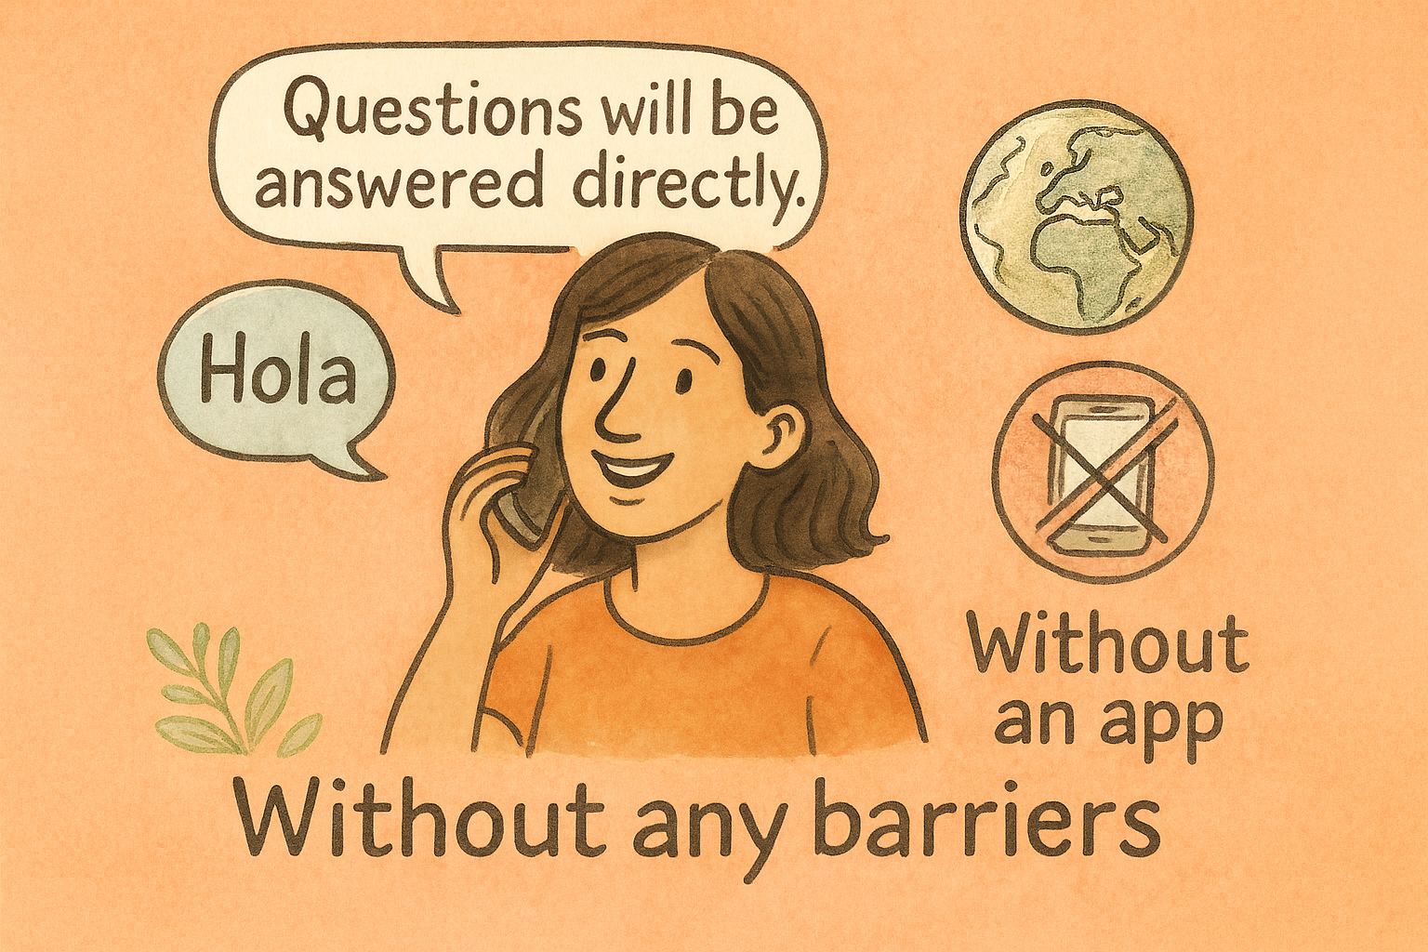
Why WaKI ?

Slide 4






How WaKI works ?
Multilingual Q&A via WhatsApp
Through dedicated WhatsApp number (+41 79 4227220) or based on the region
Automatic language recognition
Deliver clear and culturally sensitive responses.
Answers drawn from topic specific folder stored.
Data stored in Swiss servers and update continuously.
Works with Microsoft Azure (GPT) and integrates WhatsApp via WATI.io

Slide 5








Water and Forest management
Climate change
CO2 reduction
Animals and biodiversity
WaKI Content Areas
Plastic waste
Hygiene
Nutrition
Sustainable living

Slide 6
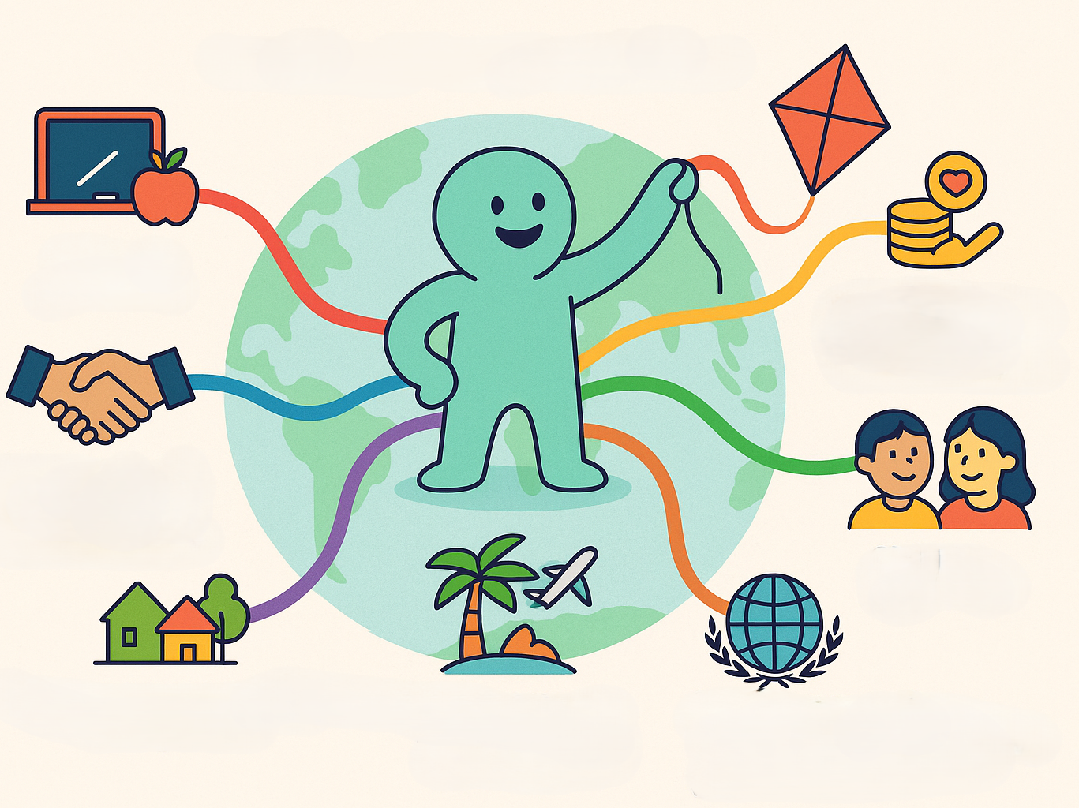
Who is WaKi for ?
Schools & teachers
Sponsor foundations & CSR partners
Government, NGOs & local partners
Children & families
Village communities and regions
International institutions (UN, UNICEF)
Airlines, airports & tourism

Slide 7








Global scalability
Country specific SIMs with regional numbers
Rapid global reach
Culturally adapted
WaKI
Switzerland
India
Kenya
Bolivia
First Test Regions – Spanning 4 Continents

Slide 8









Key benefits of WaKi
24*7 availability
100+ languages
Free
Simple access
Content control

Slide 9







GeoGreenBag
Reforestation & climate monitoring
MyCookWell
Bamboo – fired
CO2 neutral
MyFORESTS Academy
Nature education for all
WaKI
GaiaWells
Fresh drinking water access
Ask. Learn. Act
Beekeeping & biodiversity
(Pollination, nutrition, climate)
FoldPod
(Mobile education rooms)
Direct entry in these all projects by asking simple question based on the interests !

Slide 10






Impact and potential
Combines traditional knowledge with modern solutions
Strengthens local responsibility & education
Environmental awareness & skills
Supports SDGs & national education strategies
Scales efficiently via WhatsApp technology

Slide 11

Invitation to participate
Funding Partner
Foundations, CSR, Development cooperation
Strategic Multiplier
(Airline’s, Universities, Embassies)
Pilot Country
Education ministries, NGOs, UN partners
WaKI is ready for your country, your region, its schools, all people.

Slide 12

Thank you for your attention !
WaKI sets knowledge in motion, builds wherever it can grow and thrive.
Contact: MyFORESTS.ch | Think tank
info@myforests.ch | www.myforests.ch
You ask the earth answers.

